Slide 1
Comparative Evaluation of Conversational & Graphical Interfaces
Independent Study (ISM6905.001U25.50067)
Faculty Advisor: Dr. Timothy Smith
Author: Umeaiman Merchant

Slide 2
Agenda
Introduction
Previous Research
Methodology
Design
Interface Comparison
Findings
Conclusions
Future Scope
Reference

Slide 3
Introduction
Conversational AI Shift – Advances in models like GPT have enabled natural language interaction, moving beyond static menus and buttons.
Research Question – When do CUIs add real value, and when are GUIs the better choice for usability?
Case Study Approach – Built an academic course assistant chatbot to compare how CUI and GUI support tasks such as course help, assignment guidance, and content navigation.
Objective – Analyze strengths and limitations of both interfaces and propose recommendations for future educational tools needing flexibility, low friction, and engagement.

Slide 4
Previous Research
Comparative Findings – Studies show analytical users perform better with structured GUIs, while intuitive users initially prefer CUIs; however, chatbot novelty diminishes over time due to slower responses
Cognitive Load – CUIs often increase mental effort and reduce user control compared to GUIs, highlighting the importance of visual cues, quick-access features, and hybrid support.
Hybrid Advantage – Research across domains (customer service, decision support, multimodal interfaces) consistently suggests that blending GUI and CUI yields higher efficiency, satisfaction, and reduced cognitive strain.
Research Gap – Most prior work is lab-based or prototype-driven; real-world validation in education is limited. This study contributes by implementing and reflecting on a working academic chatbot in a live database-backed environment.

Slide 5
Methodology
Developed an academic assistance application using two UI approaches:
Graphical User Interface (GUI) – menu-driven, task-oriented workflows
Conversational User Interface (CUI) – AI-powered chat assistant
Both versions implemented identical functionality:
Assignment submission, course queries, feedback review, deadline checks, and instructor contact
A centralized PostgreSQL database ensured consistency by managing course info, submissions, rubrics, and user activity.

Slide 6
Design
GUI Design
Multi-pane web application with a clearly labeled menu.
Key features:
Login + dashboard (course help, assignment submission, past submissions, course info).
Structured workflows for each task
Ensures predictable, low-cognitive-load navigation with direct task access.
CUI Design
Chat-based interface with persistent dialogue history and input bar.
Supports context-aware assignment submission with dynamic pop-ups for file upload.
Allowed natural, cross-topic queries beyond fixed menus.

Slide 7
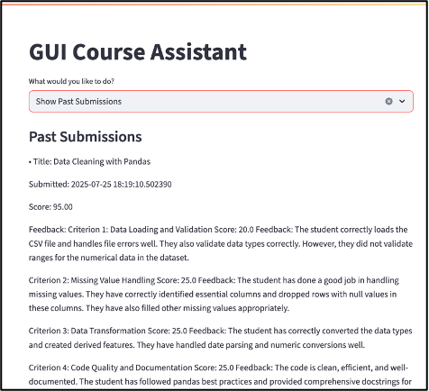
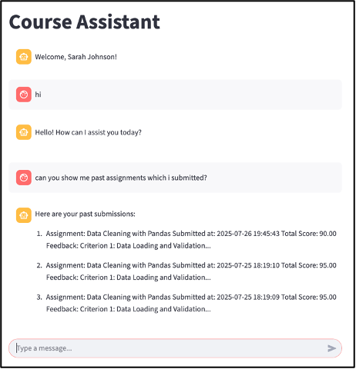
Interface Comparison
GUI Design
CUI Design

Slide 8
Findings
Ease of Development – GUI was simpler and faster to design with modular workflows, while CUI offered flexibility and reusability but required complex debugging and context handling.
Design & Aesthetics – GUI felt static and siloed, whereas CUI provided a minimalist, open-ended interaction flow.
Task Suitability – GUI worked best for quick, single-step tasks; CUI excelled in multi-step, exploratory, or cross-topic academic tasks.
Performance – GUI responded instantly, but CUI experienced noticeable latency due to LLM processing.
Accuracy & Context – GUI delivered precise, context-free execution, while CUI struggled with vague queries, weak memory, and assignment ID recognition.

Slide 9
Conclusion
Dual-Format Exploration – The study compared GUI (structured, task-focused) and CUI (flexible, conversational) designs for an academic assistant.
Key Findings – GUI ensured speed, precision, and clarity, while CUI supported multi-step, contextual, and loosely structured queries.
Trade-offs – GUI lacked continuity, whereas CUI faced latency and ambiguity in function selection.
Future Direction – A hybrid model could combine GUI’s clarity with CUI’s contextual flexibility for optimal academic support.

Slide 10

Future Scope
A structured evaluation with student participants will assess usability across GUI and CUI using surveys focused on ease of use, efficiency, preferences, and improvement areas.
Efforts will optimize the conversational assistant for speed and accuracy, while modernizing the GUI with context-aware, dynamic elements to create a more interactive and personalized user experience.

Slide 11
Reference
Basile Giannini, S., et al. (2024). Influence‑diagram–driven hybrid decision support with conversational prompts. Proceedings of the International Conference on Applied AI and Hybrid Systems. Retrieved from https://aclanthology.org/2024.clicit-1.8.pdf
CPG Project Team. (2025). Conversation Progress Guide: Enhancing self‑efficacy in conversational UIs. arXiv preprint arXiv:2501.12001. Retrieved from https://arxiv.org/html/2501.12001v2
Liu, F., Rietz, M., & Maedche, A. (2024). Conversational versus graphical user interfaces: The influence of rational decision style when individuals perform decision‑making tasks repeatedly. Universal Access in the Information Society. https://doi.org/10.1007/s10209-024-01122-1
Muxi Interface Team. (2023). Muxi multimodal interface: Text, speech, and gesture in collaborative work. European Journal of CSCW, 32(4), 201–217. Retrieved from https://dl.eusset.eu/server/api/core/bitstreams/65c039f1-bede-4841-a62c-35bc11f3cc3f/content
Nguyen, T., Sidorova, N., & Torres, R. (2022). User interactions with chatbot interfaces vs. menu‑based interfaces: An empirical study. Computers in Human Behavior, 128, 107093. https://doi.org/10.1016/j.chb.2021.107093
“Cognitive Limits of Text‑UIs.” (2025, February). Medium. Retrieved from https://arxiv.org/abs/2502.08114 StatZ Research Group. (2025). StatZ conversational analytics agent vs. traditional GUI tools. Internal report, Institute for Data Interaction.

Slide 12
Thank you
Umeaiman Merchant
U32966030

